Slide 1


Analog Electronics Fundamentals 103
-Field Effect Transistors
-Operation Amplifiers (Op-amps)
-Final Project: Create Variable power supply 3v ~ 5v with 9v input

Slide 2
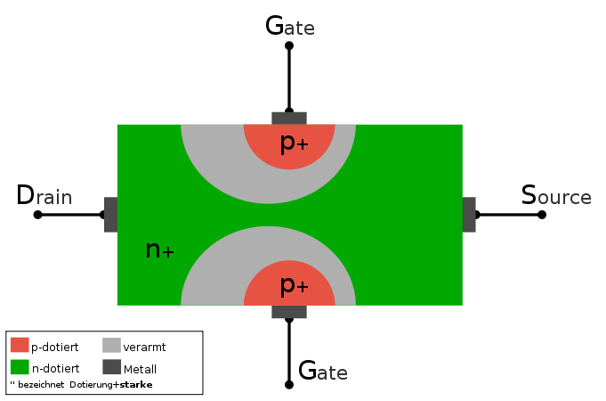
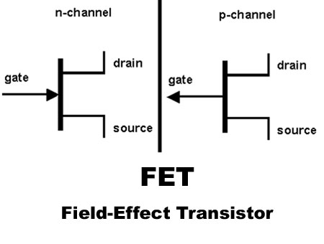
1 Field Effect Transistors (Fet)
The field-effect transistor (FET) is a transistor that uses an electric field to control the shape and hence the conductivity of a channel of one type of charge carrier in a semiconductor material. The concept of the FET predates the BJT, though it was not physically implemented until after BJTs due to the limitations of semiconductor materials and the relative ease of manufacturing BJTs compared to FETs at the time.
The FET controls the flow of electrons from the source to drain by affecting the size and shape of a "conductive channel" influenced by voltage (or lack of voltage) applied across the gate.
**Excerpts taken from: Wikipedia

Slide 3
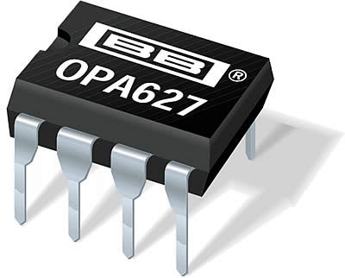
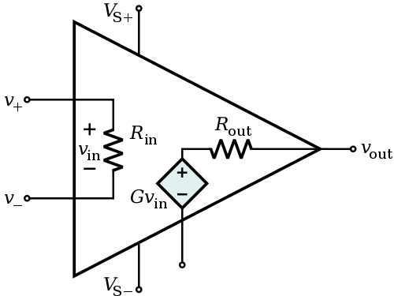
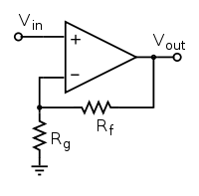
2 Operation Amplifiers (Op-amps)
An operational amplifier ("op-amp") is a high-gain electronic voltage amplifier, usually, a single output. An op-amp produces an output voltage that is typically hundreds of thousands times larger than the voltage difference between its input terminals.
Typical Applications:
Amplifiers
Oscillators
Schmidt Triggers
Signal Filters
**Excerpts taken from: Wikipedia

Slide 4
3 Final Project: Variable Supply 1.25v~Xv
PreRequisites:
Install the free version of EagleCAD ( http://www.cadsoftusa.com/download-eagle/?language=en )
Try to familiarize yourself with EagleCAD as much as possible. Some tutorials:
https://www.sparkfun.com/tutorials/108
http://www.ianstedman.co.uk/Technical/Starting_with_EagleCAD/starting_with_eaglecad.html
Project:
Schematic provided with the LM317 datasheet, on the first page. Feel free to use that as your design, or basis for your design.
You could also add improvements, like adding an LED and switch for ON/OFF.
You will need to prototype your design on a breadboard, and show it's working.
Once you have a working prototype, you can put your design's schematic in EagleCAD, and create a PCB (Printed Circuit Board Layout) for it.
Workshop 105 will be dedicated to EagleCAD circuit and PCB layout making.
During workshop 106, if you have a layout ready, we will go ahead and etch our own PCB, then drill them and populate the components. You will have made your own portable, variable power supply.
If by workshop 106 you don't have a PCB layout ready, I will make some of my proto boards available so that you can still build your designed power supply.

